Slide 1
Wu Yue/wwx291773
2020-05-30
New

Slide 2
Introduction to Multi-service Gateways

Slide 3
Huawei's next-generation NetEngine AR routers, including the AR650, AR6100, AR6200, and AR6300 series apply to different industries, network scales, and scenarios.
AR routers use leading hardware platforms and software architectures. They provide integrated network solutions to enterprise customers with the minimum investment; therefore, they can meet various application requirements of future business expansion and cope with IT industry development.
This course describes WLAN and security functions of AR routers.

Slide 4
Upon completion of this course, you will be able to:
Describe functions and features supported by AR routers.
Describe WLAN service features of AR routers.
Describe security service features of AR routers.

Slide 5
Functions and Features of AR Routers
WLAN Service Features of AR Routers
Security Service Features of AR Routers

Slide 6





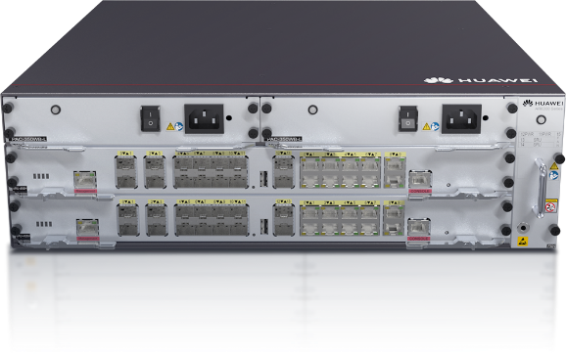
Overview of AR Routers
AR routers are mainly oriented to enterprise users. As enterprise gateways, AR routers provide all-in-one advantages.
AR routers provide routing, switching, security, voice, and WLAN functions, reducing initial investment of enterprise users.

Slide 7
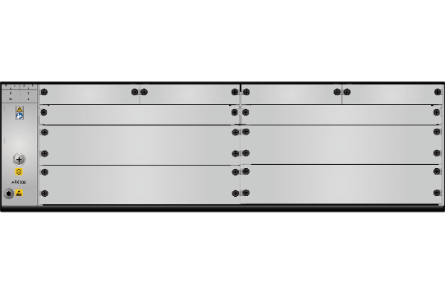

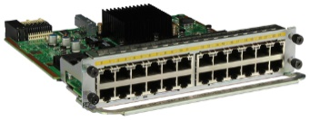

Introduction to Routing and Switching Features
The AR router can function as the egress router of a medium-sized network. It supports multiple router protocols, MPLS, multicast routing protocols, and WAN interconnection.
On a small-scale network, an AR router also provides the switching function. For example, after a switching card is installed on an AR router, the AR router can function as a switch and supports multiple Layer 2 technologies such as Virtual Local Area Network (VLAN) and Spanning Tree Protocol (STP).
Usage scenario of routing features
Usage scenario of switching features
SFU
AR router
Campus network
AR router

Slide 8

Introduction to Security Features
AR routers provide access security features, such as port security and access authentication. They support network security features, such as firewall, IPS, and URL filtering. In firewall hot standby scenarios, AR routers also support firewall hot standby.
Usage scenario of security features
AR router
Campus network

Slide 9


Introduction to WLAN Features
The AR router supports two working modes: Fat access point (AP) and access controller (AC). The working mode varies according to the usage scenario.
An AR router functions as a Fat AP and independently provides WLAN access for stations (STAs).
An AR router functions as an AC and provides access to downlink Fit APs. The AR router and Fit APs together provide WLAN access for STAs.
Usage scenario of a Fat AP
Usage scenario of AC+Fit AP
AR router
AR router
Campus network
CAPWAP

Slide 10








Introduction to Voice Features
An AR router can function as an IP PBX or a SIP gateway (SIP AG).
As an IP PBX, the AR router can connect to and control voice devices, and can also connect to traditional PBX devices.
As a SIP AG, the AR router does not provide access and control functions for voice devices, but can directly connect users to the IMS network for control.
IMS
SIP AG
SIP phone
IP PBX
IP PBX
TDM PBX
POTS
SIP phone
Fax machine
PC
POTS
SIP phone
Fax machine
PC

Slide 11
Functions and Features of AR Routers
WLAN Service Features of AR Routers
Security Service Features of AR Routers

Slide 12

Introduction to WLAN Technology
With rapid development of the Internet, the communication network has developed from the traditional cabling network to the wireless network. As one of the wireless networks, the Wireless Local Area Network (WLAN) meets people's demands of mobile office.
Wireless networks can be classified into the Wireless Personal Area Network (WPAN), WLAN, Wireless Metro Area Network (WMAN), and Wireless Wide Area Network (WWAN) based on the application scope. WLAN technology is also known as Wi-Fi.
< 10 m
< 100 m
< 5 km
< 15 km
WPAN
WLAN
WMAN
WWAN
Bluetooth
ZigBee
NFC
HomeRF
UWB
Wi-Fi
WiMax
GSM
CDMA
WCDMA
TD-SCDMA
LTE
5G
Notes:
WLAN classification:
WPAN
WLAN
WMAN
WWAN

Slide 13






Introduction to WLAN Devices
A WLAN consists of STAs, APs, ACs, network devices, and backend servers.
The AP and AC are main devices on the WLAN and are used to control and send wireless signals.
Backend servers are used for authentication, IP address distribution, and network monitoring.
Network devices are used to forward STA data.
The STA is a wireless terminal.
STA
AP
Network device
AC
Backend server
Laptop
Fit AP
Switch
AC
NMS
Tablet
Fat AP
Router
Portal server
Mobile phone
RADIUS server
DHCP server
Notes:
STA
STAs refer to access terminals, including laptops, desktop computers with wireless NICs installed, mobile phones, and PDA.
AP
APs are main devices of the WLAN and key components for wireless technologies. They provide wired connections to upstream devices and wireless access to STAs, bridging the wired and wireless networks.
Fat APs are traditional APs. In addition to wireless access, a Fat AP provides security, management, and performance enhancement functions. A Fat AP cannot associate with an AC.
Different from traditional Fat APs, Fit APs provide only reliable and high-performance wireless connections. Fit APs must work with ACs.
AC
An AC controls and manages all APs on a WLAN. It can exchange with an authentication server to authenticate WLAN users.

Slide 14

Introduction to AR WLAN Features
AR routers with a "W" in their name support the WLAN feature., for example, AR6120-VW or AR651W.
WLAN-capable AR routers have built-in antennas to support Fat AP features.
An AR router can function as a Fat AP or an AC.
AR routers support Fat AP without a license.
When the AR650 functions as an AC, no license is required. In this case, the AR650 can connect to a maximum of 16 APs.
When the AR6100, AR6200, or AR6300 functions as an AC, it can connect to a maximum of four APs if no license is loaded.

Slide 15
AR Router - Fat AP
When an AR router functions as a Fat AP, it is similar to a home wireless router. All configurations are performed locally, and wireless signals are directly sent by the AR router.
Fat APs support pre-shared key, 802.1X, and Portal authentication modes. The built-in Portal server of the AR router can be used for Portal authentication.
AR router
(Fat AP)

Slide 16
AR Router - AC
When functioning as an AC, an AR router can connect to most Huawei APs. The working principle is the same as that of a dedicated wireless AC.
AR routers support the following AC functions: basic wireless functions, roaming, radio management, wireless security, and wireless distribution system (WDS).
AR routers do not support inter-AC roaming or mesh technologies.
CAPWAP tunnel
Campus network
AP
AR router
(AC)

Slide 17
AR Router - NAC
An AR router provides Wi-Fi access authentication through the built-in network admission control (NAC) feature.
NAC provides three authentication modes: 802.1X authentication, MAC address authentication, and Portal authentication. NAC needs to be used with the AAA server to implement access authentication.
An AR router provides 802.1X authentication, MAC address authentication, and Portal authentication. Portal authentication can be implemented by an external or internal Portal server.
CAPWAP tunnel
Campus network
AR router
(AC/built-in Portal server)
AP
RADIUS server
Portal server
Notes:
AAA servers include the RADIUS server, TACACS server, and accounting server.

Slide 18
Functions and Features of AR Routers
WLAN Service Features of AR Routers
Security Service Features of AR Routers

Slide 19


Introduction to AR Security Features
All AR series routers support security features.
AR routers support the following security features:
Access security
Common access security technologies include NAC, port security, ARP security, traffic suppression, and IP source guard (IPSG).
Local security features
Common local security technologies include CPU attack defense and attack source tracing.
Firewall features
Common firewall technologies include packet filtering, stateful firewall, and blacklist and whitelist.
In-depth security defense
Common in-depth security technologies include intrusion prevention system (IPS) and URL filtering.
Deploy firewall and in-depth security features
Egress (built-in firewall/IPS)
Campus network
Deploy local security features
Deploy access security features
Authorized user
Authorized user
Authorized user

Slide 20
Introduction to Access Security Features
The network has become an important tool for information exchange. The cyber security issue needs to be resolved urgently with the wide use of network. The access switches that play an important role on the network are prone to hackers' attacks.
Access security involves the following:
Confidentiality
Integrity
Availability
Common access security technologies are as follows:
NAC, port security, ARP security, traffic suppression, and IPSG
Egress
Campus network
Access switch
Deploy access security features
Attacker
Authorized user
Authorized user
Notes:
Confidentiality: When a switch stores, handles, and transmits data, the data will not be leaked to unauthorized users, entities, or procedures. Information can only be accessed by authorized users.
Integrity: Data cannot be modified without permission. Information stored or transmitted by switches is free from corruption or loss caused by accidental or malicious deletion, modification, falsification, disordering, relocation, or insertion.
Availability: The given functions of a switch can be executed under the specified conditions and at the specified time or time period when the required external resources are ensured. Services are always available and meet carrier-class QoS requirements.

Slide 21
Introduction to Local Security Features
Device CPUs need to process a large number of packets including valid packets and malicious attack packets on a network.
To ensure that the CPU can properly process and respond to normal services, the device provides the local attack defense function.
Common local security technologies are as follows:
CPU attack defense and attack source tracing
Egress
Campus network
Deploy local security features
Access switch
Attacker
Authorized user
Authorized user

Slide 22
Introduction to Firewall and In-Depth Security Defense Features
Access security features are used to protect the internal network and focus more on validity of access devices or users.
Firewall and in-depth security defense features focus more on validity of traffic between the intranet and extranet and validity of services carried over the traffic.
Common firewall and in-depth security defense technologies are as follows:
Firewall and connection control technology
IPS
URL filtering
Attack defense
Deploy network and service security features
Egress (built-in firewall/IPS)
Campus network
Access switch
Authorized user
Authorized user
Authorized user

Slide 23
(True or false) Huawei AR routers can be used as Fat APs or Fit APs.
True
False
(True or false) Huawei AR routers can be used as firewalls, but do not support firewall hot standby.
True
False
Notes:
1. B
2. B

Slide 24
AR routers provide routing, switching, security, voice, and WLAN functions.
Routing and switching functions: It has similar functions of a Huawei switch.
Security functions: It provides similar functions of a Huawei firewall, such as IPS and URL filtering.
WLAN function: It can be used as a Fat AP or an AC.
Voice capability: It can be used as an IP PBX or SIP AG.

